Slide 1
Disclaimer: don’t worry if you are not learning now the specific different algorithms. It is much more important to know this section. In an interview, this is a fundamental part.

Slide 2
Typical ML pipeline in a Supervised Learning
ML process and pipeline

Slide 3
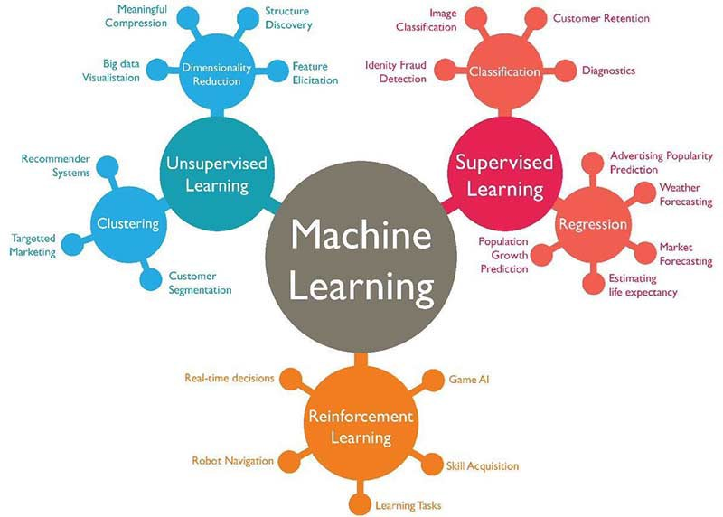
Typical ML pipeline
ML process

Slide 4
Typical Pipeline of ML
Machine Learning is a process, step by step.
60% of your time
1.Get Data
Exploration
Cleaning / Transform Data
10% of your time
20% of your time
Data wrangling, sometimes referred to as data munging, is the process of transforming from one "raw" data form into another format with the intent of making it more appropriate and valuable for a variety of downstream purposes such as analytics.
Model Creation and Performances
Deploy and Production
10% of your time

Slide 5
How to get data
Usually a dataset in csv, or any file with information

Slide 6
Train - test split
What they are, why they are used

Slide 7
Typical Pipeline in Supervised Learning
Dirty/Raw Data
80%
Dirty Training Set
Exploration + Transformation Pipeline (P)
Model ML
20%
Dirty Test Set
Pipeline P
Performances

Slide 8
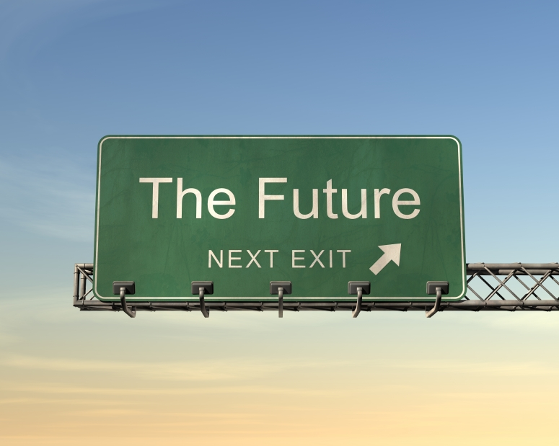
2. Create Training Set and Test Set
GOAL: train a model on data we have and measure the performance of predictions on unseen data
80% of dataset
20% of dataset
TRAINING SET
TEST SET
The model is TRAINED on TRAINING SET
The performance are measured on TEST SET. The model can’t see the target, but must predict it
Here the model can see the input and the output (target variable)
From NOW ON, forget about the TEST SET. Imagine the test set as something we don’t have. Think of it as something that will be available ONLY TOMORROW. Test set is only used to evaluate the generalization power of the final model.

Slide 9
2.Test set is a sample of data from the same distribution of training set
Splitting Training set and Test set imply (we make the assumption that) the Training set data and Test set data follow the same statistical distribution. In fact, the Test set should be a smaller version of the Training set (same characteristics).
80% of dataset
20% of dataset
TRAINING SET
TEST SET
The model is TRAINED on TRAINING SET
The performance are measured on TEST SET. The model can’t see the target, but must predict it
Here the model can see the input and the output (target variable)

Slide 10
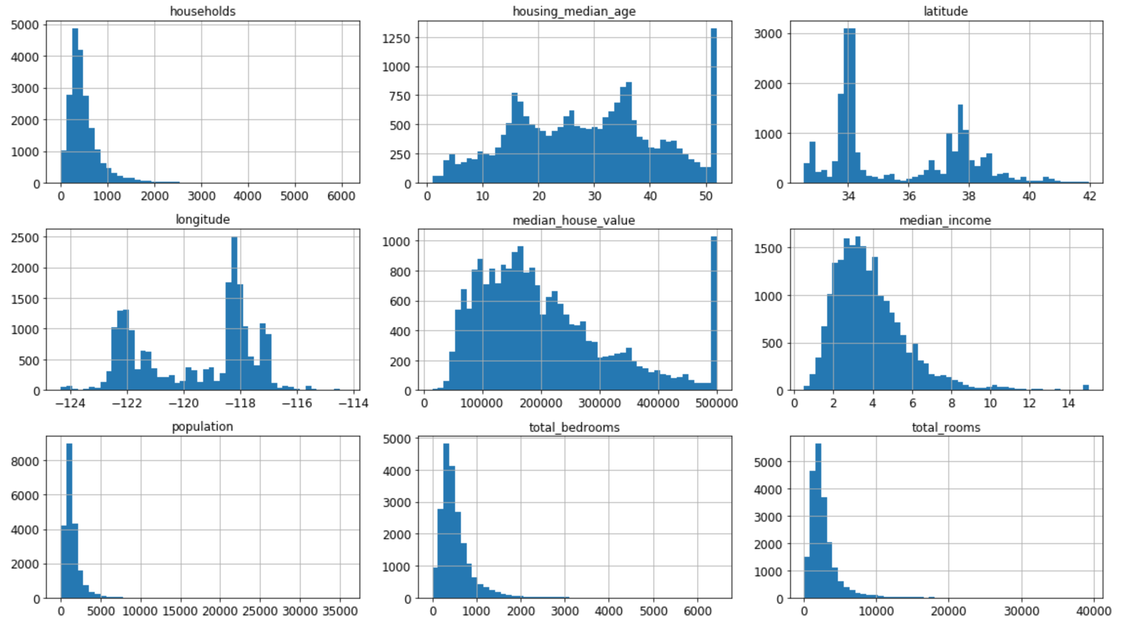
3. Data Exploration on the Training Set
Take the training set and explore the features. Check if you can spot something “strange” in the data (anomalous data) by plotting the features.

Slide 11
4. Preprocessing and Cleaning data
In Machine Learning it is typical to clean and preprocess data before building the model. This phase is usually long because a good preprocessing can improve the result of the model. In ML it is famous saying:
GARBAGE IN → GARBAGE OUT
If you give your model bad data, dirty data, the results is not good (GARBAGE). The goal of this step is creating the necessary steps to take raw data and prepare them for ML model.
Raw/Dirty/Untidy Data
Pipeline
Tidy Data
This step include cleaning data, filling missing values, normalize and transform the data (like normalizing the data…)

Slide 12
5. Create the best model on training set
Generally, the test set is set apart and never touched till the end of the process (model creation) because the test set simulates “future” data that now are not available.
Hence, it would be conceptually wrong to take decision now about the model based on “future unseen data”. This error is called “Data Snooping Bias”, introducing information from Test set.
Forget about the TEST SET, use it only at the final model evaluation (generalization error) and imagine that the test set comes from the future (we don’t have it now)
80% of dataset
TRAINING SET
The model is TRAINED on TRAINING SET

Slide 13
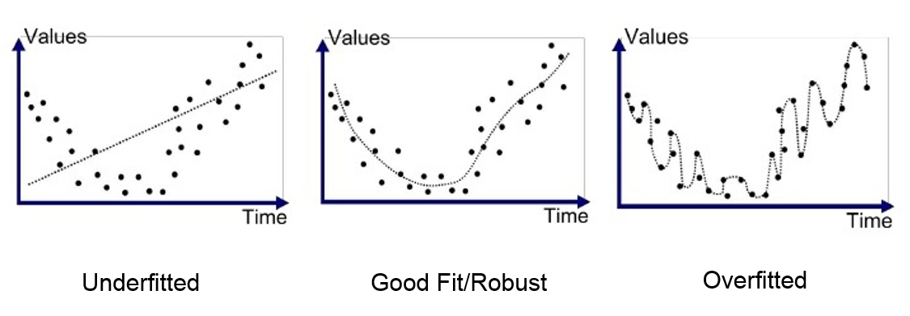
5. Create the best model on training set
Before training you should decide:
The hyperparameters (complexity of the model)
This step imply, for example, for Linear Regression: which alpha value should I choose for regularization? Don’t worry, very soon an example on notebook.

Slide 14

5. Evaluate your model on TEST set
Now it’s time to use your test set to EVALUATE your model.
The TEST set is the LAST thing to use because it simulates data we don’t have (once the model is in production).

Slide 15



6. Deploy it: create a service, maintain and monitor it
Once the model works well, it is possible to use tools like Flask or Django to open API service to your model.
Usually, we need a remote machine connected to the web, able to take requests and send our model predictions. The service should be reliable (no stop), scalable (if millions of users connect to the service), monitored (to monitor the performances of the model in time).
Track and monitor performances
To maintain system alive and scalable
To create API services

Slide 16

Why do you divide in training set and test set?
Dividing data in Training Set and Test set is very important, usually in proportion 80%, 20%.
In fact, we train the model on training set and evaluate the performances on the test set. It is very important that the test set is hidden during the training phase. Any information that is passed from training set to test set is called “information leakage” and is bad, because we are “cheating”.
Imagine we trained a model on training set, and we are happy and we think it works. But, before putting it in production (use the model) we would like to know how it behaves on new data, that the model never saw before: the test set.
If the model performs well on training set and bad on test set, the model is not ok and we have a problem (very common in Machine Learning): the overfitting.
GO TO THE NOTEBOOK TITANIC to see train_test_split

